Slide 1
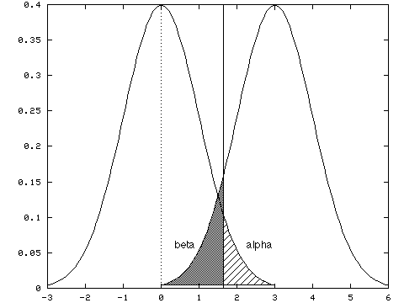
Week 6: Tests of difference; Midterm reflections
Geog4300: Shannon

Slide 2
This week
Hypothesis testing
One- and two-sample tests of difference

Slide 3

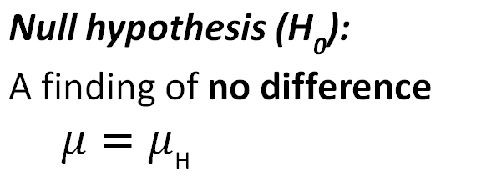
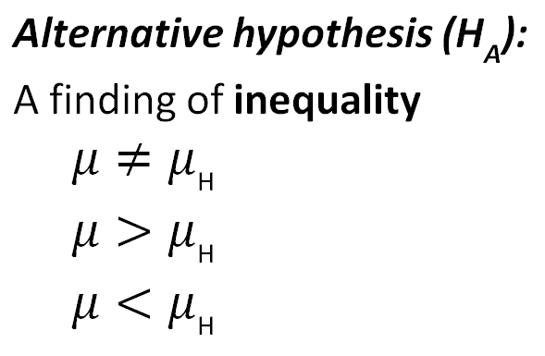
Ingredients of classical hypothesis testing
Notes:
Alternative hypothesis is usually what you’re trying to prove.

Slide 4
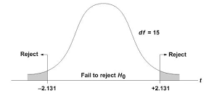
Reject or fail to reject?
Based on test results, we reject or fail to reject the null hypothesis.
We don’t prove or disprove it, but show it is likely or unlikely to be true.
Notes:
Alternative hypothesis is usually what you’re trying to prove.

Slide 5
Hypothesizing
Give the null and alterative hypothesis for the following research questions.
Is the average commute time higher on Mondays than it is the rest of the week?
Is the amount of property damage from severe weather different between southern states?
Is there an association between college teams’ football records and rates of student enrollment?
Is the rate of flu cases low in our area compared to our state?
Notes:
Alternative hypothesis is usually what you’re trying to prove.

Slide 6
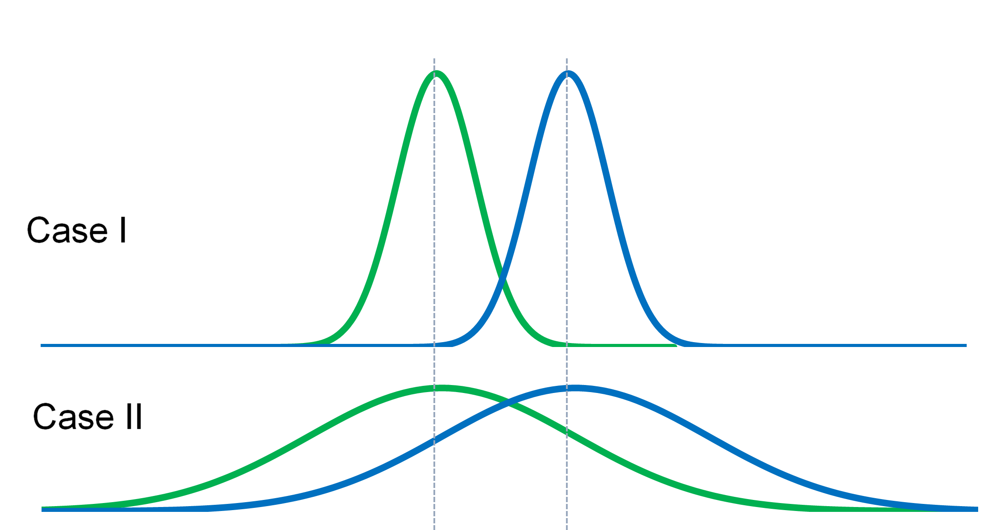
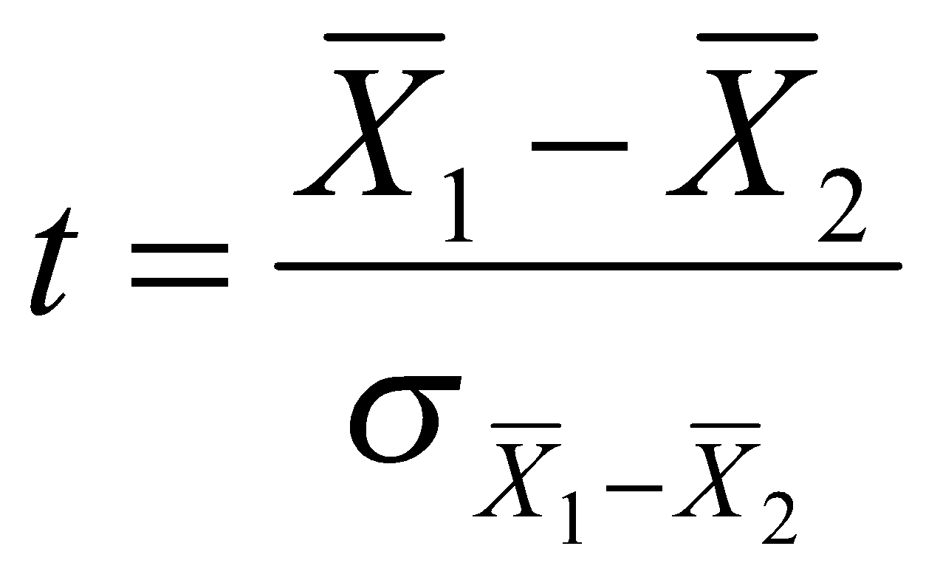
Tests of difference
Is there a difference?

Slide 7
Tests of difference
What is the specific purpose of this test? When would you use it rather than another one?
One sample t-test
Two sample t-test with equal variance
Two sample t-test with unequal variance
Two sample paired t-test
Non-parametric (Wilcoxon) t-test
Difference between two proportions

Slide 8

One sample t-test
Example: Are oak trees in our area (n=28) the same age as those throughout the state?
Sample area:
Mean age: 65 years Standard deviation: 7.3 years
State:
Mean age: 57 years
$$t=\frac{\overline{x} − μ}{s/{\sqrt{n}}}$$

Slide 9
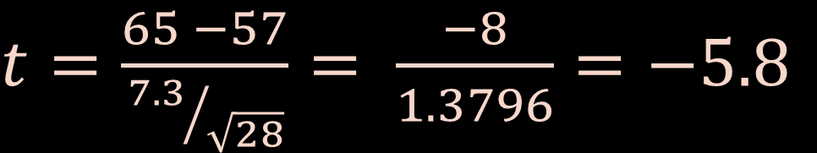
One sample t-test
Example: Are oak trees in our area (n=28) the same age as those throughout the state?
Sample area:
Mean age: 65 years Standard deviation: 7.3 years
State:
Mean age: 57 years
$t=\frac{65 −57}{{7.3}/{\sqrt{28}}}= \frac{−8}{1.3796}=−5.8$
$$t=\frac{\overline{x} − μ}{s/{\sqrt{n}}}$$

Slide 10
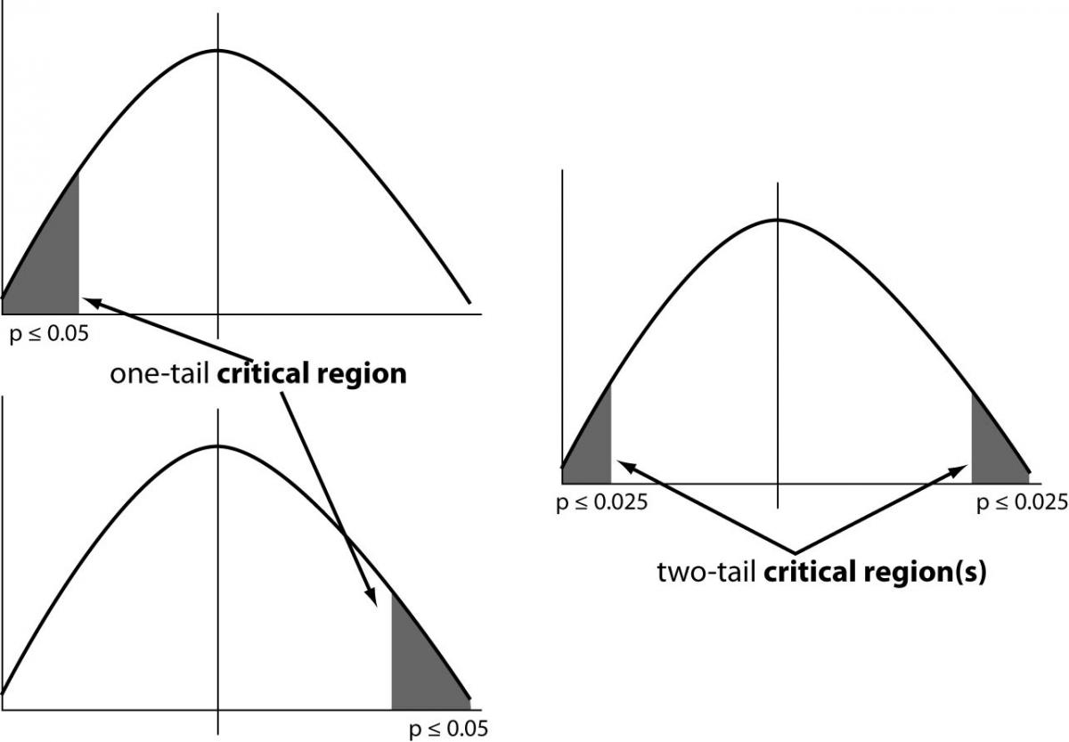
Interpreting results
Is this a one-tailed or two-tailed test?
Is the result above/below the critical value for significance?
P < 0.05:
These results are possible in <5% of all possible samples in which the two means are equal.

Slide 11
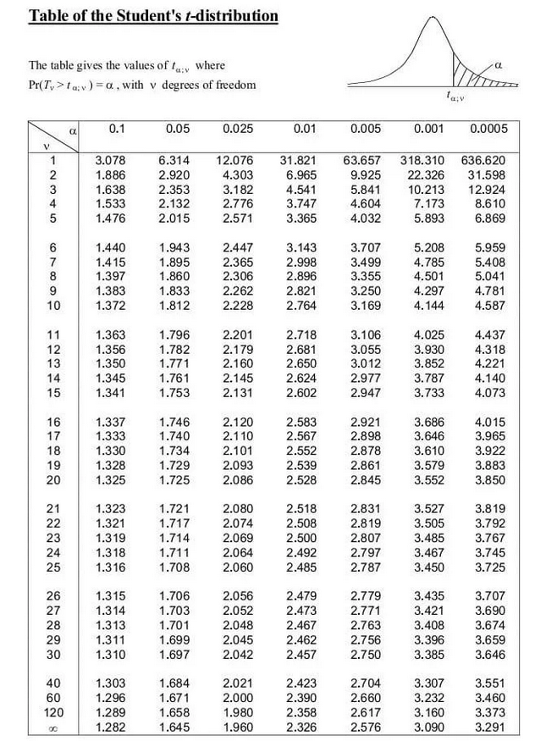
Interpreting results
Is this a one-tailed or two-tailed test?
Is the result above/below the critical value for significance?
Degrees of freedom:
One sample test: n-1 (28 in our case)
Critical value:
Based on confidence level (alpha) and df

Slide 12
Interpreting results
Is this a one-tailed or two-tailed test?
Is the result above/below the critical value for significance?
Degrees of freedom:
One sample test: n-1 (28 in our case)
Critical value:
Based on confidence level (alpha) and df
How do we interpret a t-score of -5.8?

Slide 13
Let’s try it out
The American Community Survey indicates that statewide, the average commute time is 22 minutes
We surveyed 37 community members:
Mean commute: 17.2 minutes
Standard deviation: 3.2 minutes
Is our group different from the state average?

Slide 14


How are proportions different?
The standard error is different for proportions/rates.
We also use a z statistic rather than a t-statistic
T-test for counts
Z-test for proportions
$$t=\frac{\overline{x} − μ}{s/{\sqrt{n}}}$$
$$z=\frac{\hat{p} − ρ}{\sqrt{{(p∗(1−p)}/n}}$$

Slide 15
Midterm reflection
How often have you watched the online videos?
How often have you submitted assignments on time (or nearly on time)?
What are two things you have learned about data science and quantitative analysis that are NOT about learning R/coding?
What is at least one thing you have found valuable about your work in R/Rstudio/Github?
What do you want to gain or improve on as a learner from the remainder of this course?
Are there any changes I could make to the course to help you as a learner?

